Slide 1

Spring vs Spring Boot

Slide 2
Spring vs Spring Boot
Spring Boot
Spring Farmwork

Slide 3
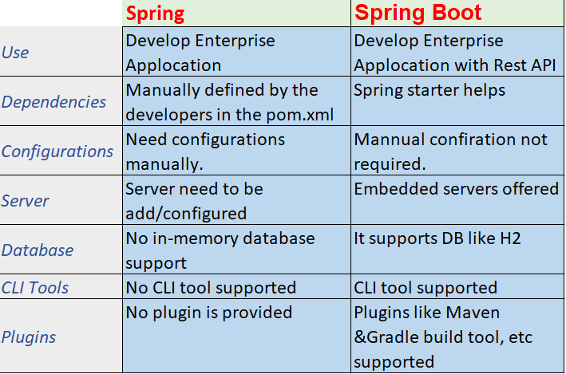

Slide 4
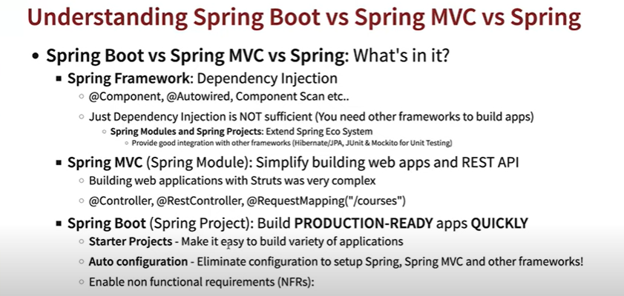

Slide 5
Thank you….

